Slide 1
Lead Scoring Case Study
By
Abhishek Gupta and Utkarsh Manishekhar

Slide 2
Problem Statement
An education company named X Education sells online courses to industry professionals. On any given day, many professionals who are interested in the courses land on their website and browse for courses.
The company markets its courses on several websites and search engines like Google. Once these people land on the website, they might browse the courses or fill up a form for the course or watch some videos. When these people fill up a form providing their email address or phone number, they are classified to be a lead. Moreover, the company also gets leads through past referrals. Once these leads are acquired, employees from the sales team start making calls, writing emails, etc. Through this process, some of the leads get converted while most do not. The typical lead conversion rate at X education is around 30%.
There are a lot of leads generated in the initial stage, but only a few of them come out as paying customers. In the middle stage, you need to nurture the potential leads well (i.e. educating the leads about the product, constantly communicating etc. ) in order to get a higher lead conversion.
X Education has appointed you to help them select the most promising leads, i.e. the leads that are most likely to convert into paying customers. The company requires you to build a model wherein you need to assign a lead score to each of the leads such that the customers with higher lead score have a higher conversion chance and the customers with lower lead score have a lower conversion chance. The CEO, in particular, has given a ballpark of the target lead conversion rate to be around 80%.
Goals of the Case Study
Build a logistic regression model to assign a lead score between 0 and 100 to each of the leads which can be used by the company to target potential leads. A higher score would mean that the lead is hot, i.e. is most likely to convert whereas a lower score would mean that the lead is cold and will mostly not get converted.

Slide 3
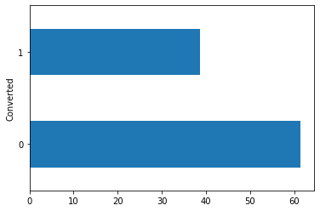
Conversion Rate
We can see that overall conversion rate of the whole data is 38.5%

Slide 4
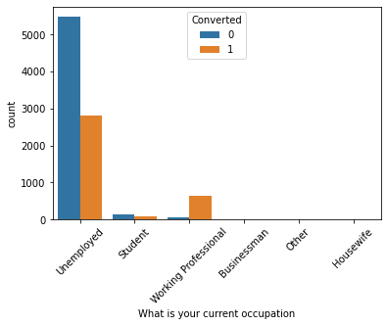
Occupation
Conversion Rate for Working Professionals is high.
Maximum number of leads are generated by unemployed customers.

Slide 5
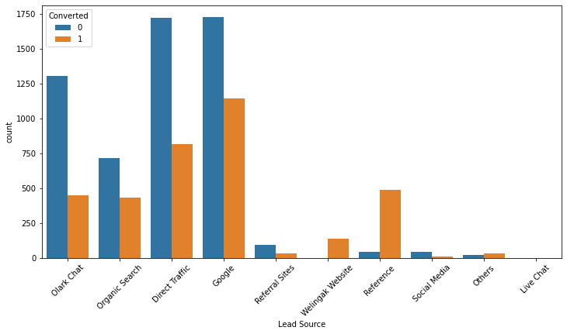
Lead Source
Maximum number of leads are generated by Google and Direct traffic.
Conversion Rate of reference leads and leads through welingak website is high.

Slide 6
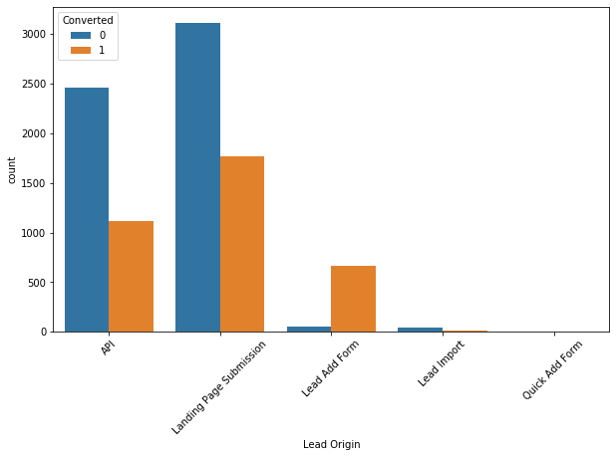
Lead Origin
API and Landing Page Submission bring higher number of leads but and the conversion rate for them is around 50%.
Lead Add Form has a very high conversion rate but count of leads is less.
Lead Import and Quick Add Form get very few leads.

Slide 7
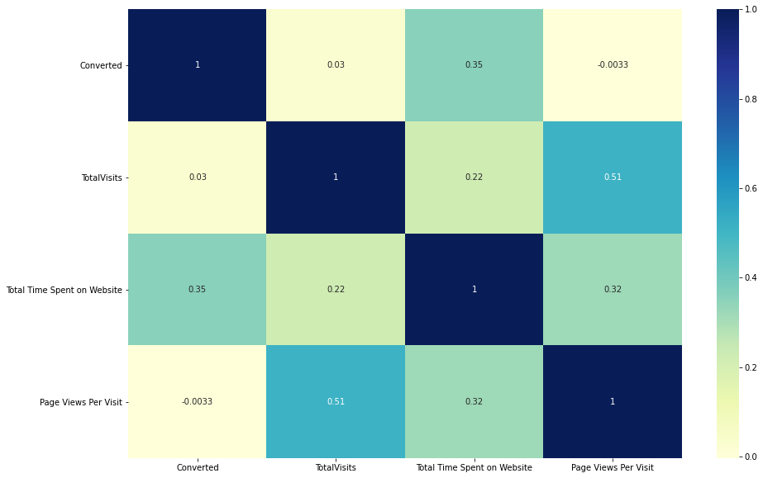
Correlation Heat-Map
There is some correlation between Converted and total tome spent on the website.
Also there is some correlation between totalvisits and page views per visit.

Slide 8
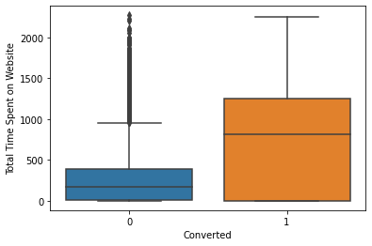
Total Time Spent on Website
Leads spending more time on the website are more likely to be converted.

Slide 9
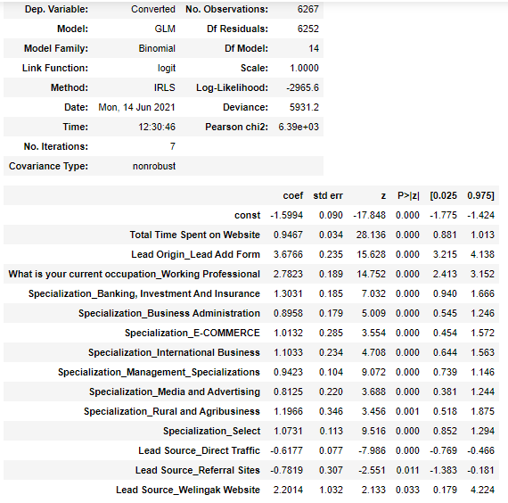
Final Modal Stats

Slide 10
Final Modal Stats
First we have taken given all the independent variable to RFE and selected 15 variable from RFE.
Using stats modal the these 15 features are used to build a model
Using p-value and VIF we have dropped the feature who where insignificant andwas correlated to other independent variable.
We can see that in final model, all the features are significant as p-value of all the features is less the 5%.

Slide 11
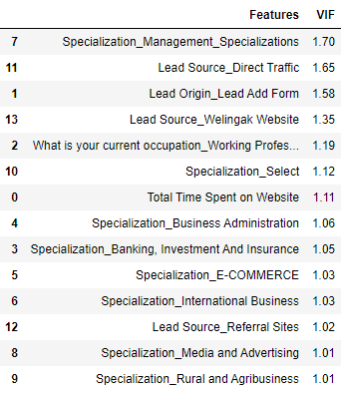
VIF Analysis
As we can see that VIF of all the features are less than 2 which means that in our final modal multicollinearity issue is not present.

Slide 12
Confusion Matrix with lead Conversion Prob > 0.5
Predicted Actual | Not_Conv | Conv
Not_Conv | 3429 | 453
Conv | 891 | 1494
As we can see from the above matrix true positive according to modal is 1494.
True negative according to modal is 3429.
False positives according to modal is 891.
False negatives according to modal is 453.
Accuracy= 0.785, Sensitivity= 0.626, Specificity= 0.883
False Positive Rate= 0.116, Positive predictive value= 0.767, Negative predictive value= 0.793

Slide 13
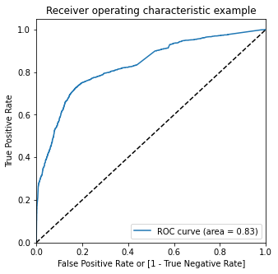
ROC Curve
Area under the curve is 0.83 which is very close to 1 so we can say that prediction power of modal is very well.

Slide 14
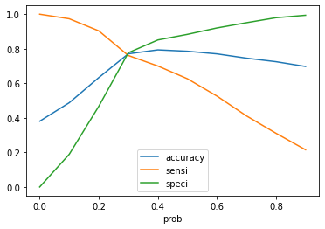
Optimal Cutoff Point
Optimal cutoff probability is that probability where we get balanced sensitivity specificity and accuracy.
From above image we can see that the Optimal Cutoff Point is somewhere around 0.3.

Slide 15
Confusion Matrix with lead Conversion Prob > 0.3
Predicted Actual | Not_Conv | Conv
Not_Conv | 3016 | 866
Conv | 570 | 1815
As we can see from the above matrix true positive according to modal is 1815.
True negative according to modal is 3016.
False positives according to modal is 570.
False negatives according to modal is 866.
Accuracy= 0.77, Sensitivity= 0.761, Specificity= 0.776
False Positive Rate= 0.223, Positive predictive value= 0.676, Negative predictive 0.841
Precision= 0.767, Recall= 0.761

Slide 16
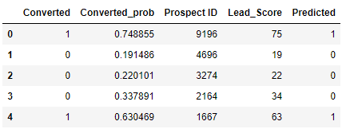
Lead Score in Train set
A Lead score is added to Training set from 0 to 100 where 0 means lest likely to get converted and 100 means most likely to get converted.
The above table shows the first 5 rows of the Training dataset.

Slide 17
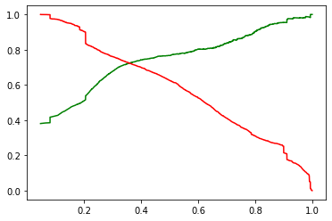
Precision and Recall Tradeoff
Green curve is Precision and red curve is Recall.
We can see the precision curve a little jumpy at the end as the denominator of the precision formula is not fixed.
In Recall curve id not jumpy in nature as the denominator is fixed in recall formula.

Slide 18
Confusion Matrix for Test Set
Predicted Actual | Not_conv | Conv
0 | 1304 | 372
Conv | 227 | 783
As we can see from the above matrix true positive according to modal is 783.
True negative according to modal is 1304.
False positives according to modal is 227.
False negatives according to modal is 372.
Accuracy= 0.776, Sensitivity= 0.775, Specificity= 0.778
Precision= 0.677, Recall= 0.775

Slide 19
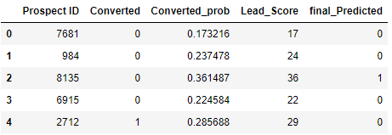
Lead Score in test set
A Lead score is added to test set from 0 to 100 where 0 means lest likely to get converted and 100 means most likely to get converted.
The above table shows the first 5 rows of the test dataset.

Slide 20
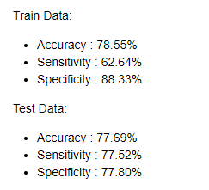
Final Observations and Conclusion
The Model seems to predict the Conversion Rate very well and we can make calls based on this model.
Team should approach to all those costumes how are spending more time on the website.
Team should approach to all Those costumes how are working professionals.
Team should approach to all Those costumes how are filling up the add forms.
Team should approach to all Those costumes how are coming from Welingak website.

Slide 21
Thank You

